Slide 1
Guide: Mrs.krishna kandwala
C.K. Pithawala College of Commerce-Management-Computer Application
Project Title :
College Resource management
Submitted By: Keval Engineer

Slide 2
Project Profile
Project Title : College Resource management
Project Type : management Website
Project Objective : To provide Subject Matirial And Notes
Project Guide : Mrs. krishna kandwala
Team Member : 2
Front-End : Html, CSS, JavaScript, Bootstrap
Back-End : PHP
Submitted By : Keval Engineer

Slide 3
CONTENTS
Introduction
Project Profile
Project Introduction
Environmental Description
Hardware & Software Requirements
Tools & Technology
Proposed System
Scope

Slide 4
UML Diagrams
Use Case Diagram
Activity Diagram
System Diagrams
Table Structure
Screen Layout

Slide 5
Project Profile
Introduction
Project Introduction

Slide 6
Project Introduction
What is This Platform?: A digital space where students can Download Subjects Notes Pdf.
Why It Matters: Highlight Student can Easily Download
Subjects Notes And Material From Their Collage Website.

Slide 7
ENVIRONMENTAL DESCRIPTION
Hardware & Software Requirement
Tools & Technology

Slide 8
HARDWARE & SOFTWARE REQUIREMENTS
Client Side :
- Internet enabled devices with Web Browser
Server Side :
- Xamp Server
- Disk Space (1 GB)
Development Side :
- Processor (Intel® Core™ -4510U)
- O.S (Windows 11)
- Memory (8 GB)
- Hard Disk (500 GB)
- Web Browser :Developed in Google Chrome(tested in Microsoft Edge)

Slide 9
TOOLS
Documentation Tool
Development Tool
MS word
MS power point
Visual Studio Code

Slide 10
TECHNOLOGIES
Front End
Back End
HTML
CSS
JavaScript
Bootstrap
Technologies
MySQL
JavaScript
Xampp

Slide 11
PROPOSED SYSTEM
Aim & objectives
Scope

Slide 12
AIM & OBJECTIVES
Upcoming Features:-
Admin,Teacher also manages the Subject Notes.
User can give Feedback

Slide 13
SCOPE
Scope
Admin
Teacher.
User

Slide 14
Admin
Admin do all the task dose. As well as they have a permission(Insert , Update , Delete).
Admin can register.
Admin can Add And Delete Course
The main admin handles the authentication process and the database.
The main admin manages College Student And Teachers details .
Admin manages the Student account like active Or deactive Account .
Admin can manage its own password.

Slide 15
Teacher
Teacher Can login And manage its own profile
Teacher can see The assign Subject-class notification given by admin
Teacher can also change the password of its own account

Slide 16
Student
Students can register, login and manage the profile through website.
Students can see Subject Notes provided by the website .
Students can use all Website features after Registration.
Students also sends the request for the registration to the admin.

Slide 17
Diagrams

Slide 18
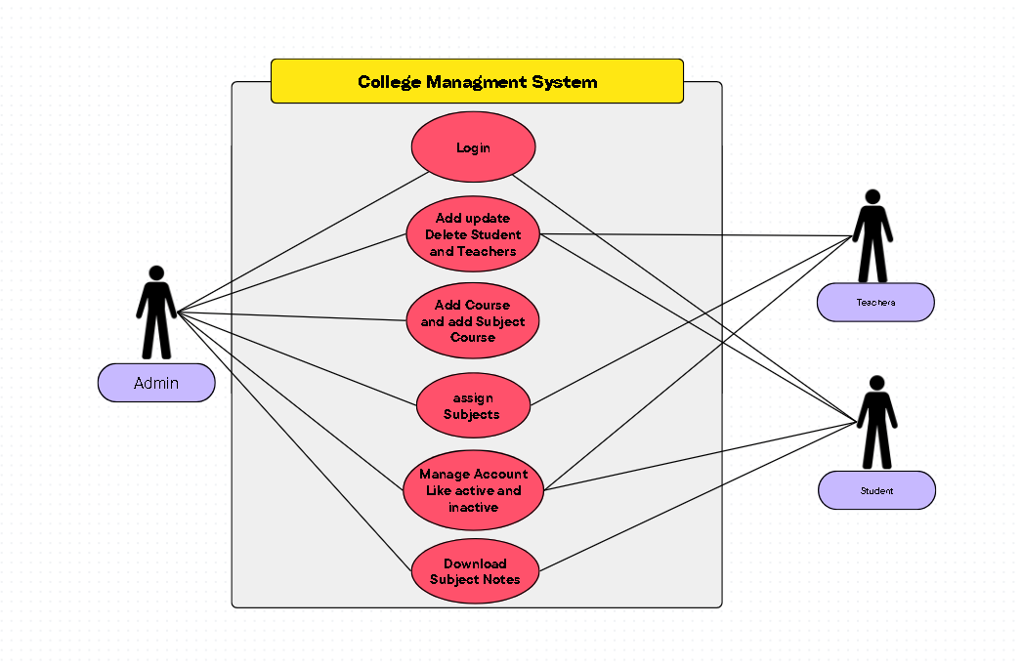
Use Case Diagram

Slide 19
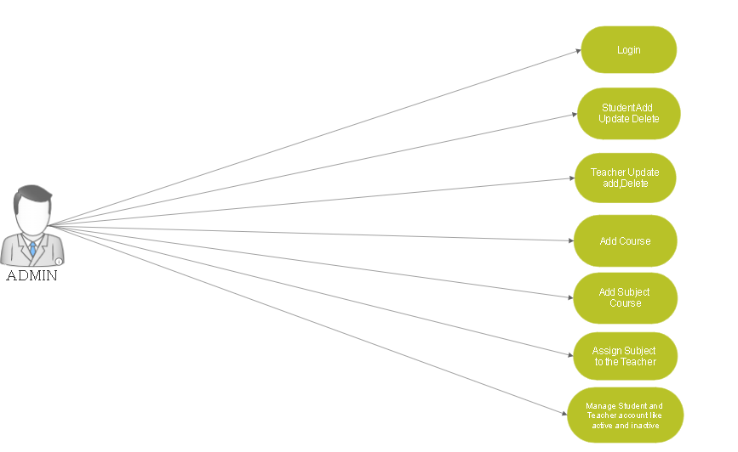
Admin UML:_

Slide 20
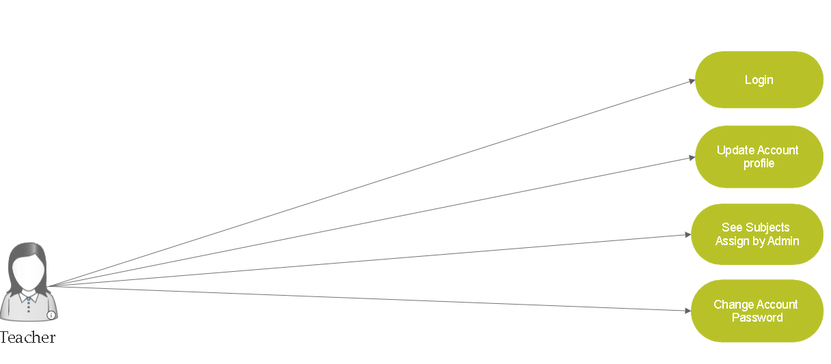
TEACHER UML:_

Slide 21
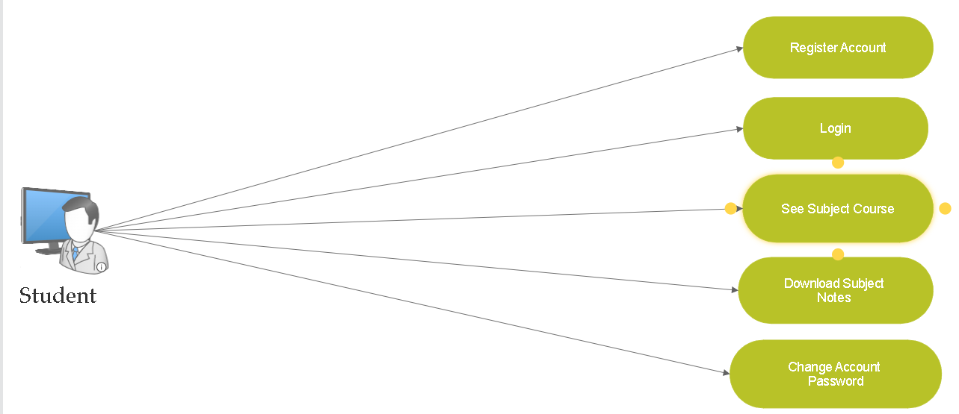
STUDENT UML:_

Slide 22
Activity Diagram

Slide 23
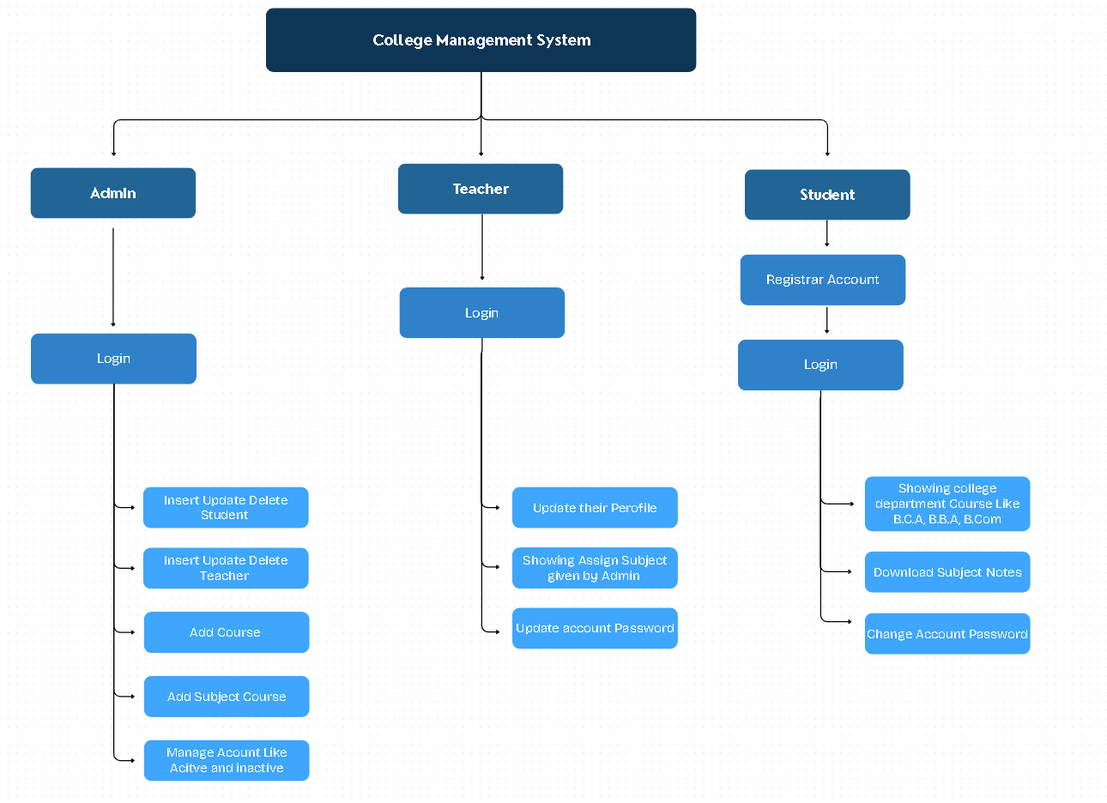

Slide 24
Table-Structure

Slide 25
Table Name :-Login Table Use :Admin Student And faclty Can Login
Name | Type | Collation | Null | Default | Extra
ID | int(11) |  | No | None | AUTO_INCREMENT
user_id | varchar(30) | latin1_swedish_ci | No | None
Password | varchar(30) | latin1_swedish_ci | No | None
Role | varchar(10) | latin1_swedish_ci | No | None
Account | varchar(20) | latin1_swedish_ci | No | None

Slide 26
Table Name : Student_info Table
Name | Type | Collation | Null | Default | Extra
roll_no | int(20) |  | No | None | AUTO_INCREMENT
first_name | varchar(30) | latin1_swedish_ci | No | None
middle_name | varchar(30) | latin1_swedish_ci | No | None
last_name | varchar(30) | latin1_swedish_ci | No | None
email | varchar(30) | latin1_swedish_ci | No | None
mobile_no | varchar | latin1_swedish_ci | No | None
course_code | varchar(11) | latin1_swedish_ci | No | None
session | varchar(10) | latin1_swedish_ci | No | None
profile_image | varchar(100) | latin1_swedish_ci | No | None
Dob | varchar(10) | latin1_swedish_ci | No | None
gender | varchar(10) | latin1_swedish_ci | No | None
permanent_address | varchar(150) | latin1_swedish_ci | No | None
current_address | varchar(150) | latin1_swedish_ci | No | None
admission_date | Timestamp | latin1_swedish_ci | No | current_timestamp() | ON UPDATE CURRENT_TIMESTAMP()

Slide 27
Table Name : Teacher_info Table
Name | Type | Collation | Null | Default | Extra
teacher_id | int(11) |  | No | None | AUTO_INCREMENT
first_name | varchar(30) | latin1_swedish_ci | No | None
middle_name | varchar(30) | latin1_swedish_ci | No | None
last_name | varchar(30) | latin1_swedish_ci | No | None
email | varchar(30) | latin1_swedish_ci | No | None
phone_no | Varchar(11) | latin1_swedish_ci | No | None
profile_image | blob |  | No | None
teacher_status | varchar(20) | latin1_swedish_ci | No | None
dob | varchar(15) | latin1_swedish_ci | No | None
gender | varchar(10) | latin1_swedish_ci | No | None
permanent_address | varchar(150) | latin1_swedish_ci | No | None
current_address | varchar(150) | latin1_swedish_ci | No | None
hire_date | varchar(15) | latin1_swedish_ci | No

Slide 28
Table Name :Teacher Courses Table
Name | Type | Collation | Null | Default | Extra
teacher_courses_id | int(11) |  | No | None | AUTO_INCREMENT
course_code | varchar(10) | latin1_swedish_ci | No | None
Semester | int(11) |  | No | None
teacher_id | varchar(10) | latin1_swedish_ci | No | None
subject_code | varchar(10) | latin1_swedish_ci | No | None
assign_date | varchar(10) | latin1_swedish_ci | No | None
total_classes | int(11) |  | No | NoneSS

Slide 29
Table Name : Courses Table
Name | Type | Collation | Null | Default | Extra
course_code | varchar(10) | latin1_swedish_ci | No | None
course_name | varchar(50) | latin1_swedish_ci | No | None
semester_or_year | varchar(10) | latin1_swedish_ci | No | None
no_of_year | int(10) |  | No | None
Name | Type | Collation | Null | Default | Extra
course_code | varchar(10) | latin1_swedish_ci | No | None
course_name | varchar(50) | latin1_swedish_ci | No | None

Slide 30
Table Name : Course_Subject Table
Name | Type | Collation | Null | Default | Extra
subject_code | varchar(10) | latin1_swedish_ci | No | None
subject_name | varchar(50) | latin1_swedish_ci | No | None
course_code | varchar(10) | latin1_swedish_ci | No | None
semester | int(10) |  | No | None
credit_hours | int(5) |  | No | None
Name | Type | Collation | Null | Default | Extra
subject_code | varchar(10) | latin1_swedish_ci | No | None

Slide 31
Screen Layout

Slide 32
Admin Panel

Slide 33
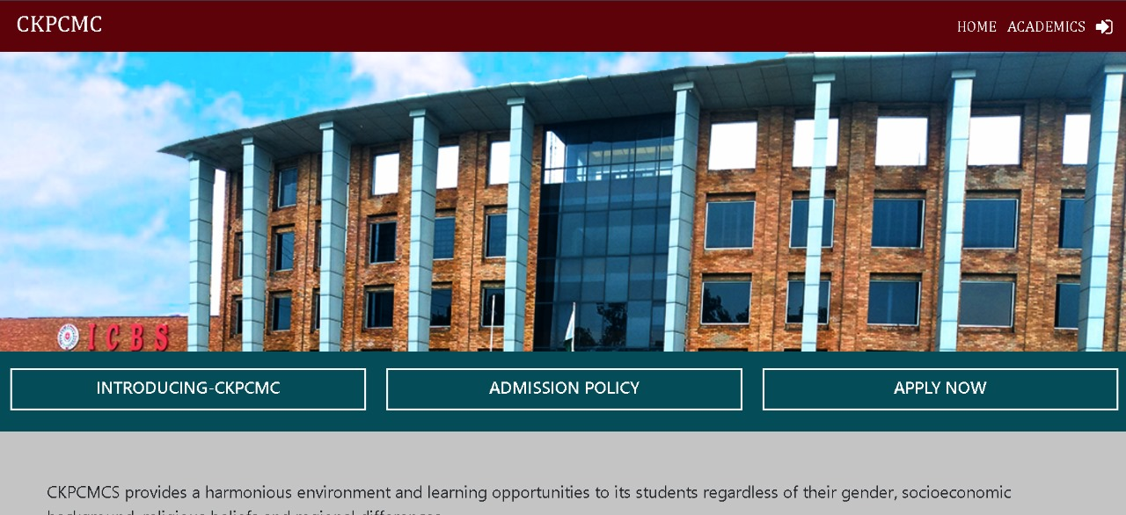
Dashboard
Use:- Admin Teachers Student Can Login Their Account

Slide 34
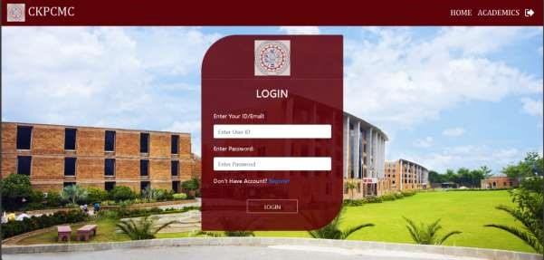
Admin-Login
Use:- Here Admin Login It’s Account

Slide 35
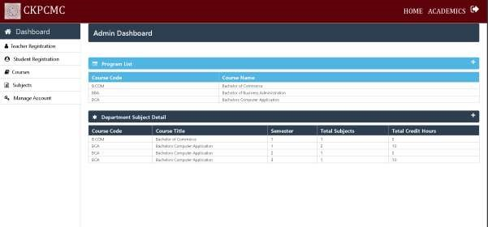
Admin-Dashboard
Use:- Here Admin Can Registration Student AndTeacher.Admin Aslo Add Course ,Add Subject Course And Also Manage Student And Teacher Account Active And inacitve

Slide 36
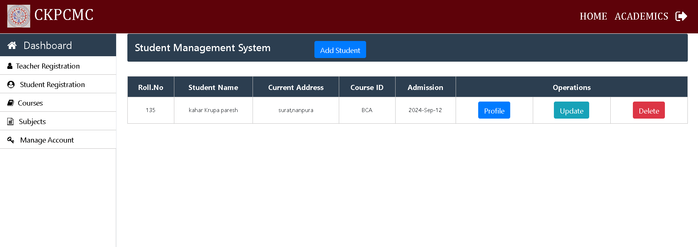
Admin-Dashboard
Use:- Here Admin Can Add Update And Delete Student

Slide 37
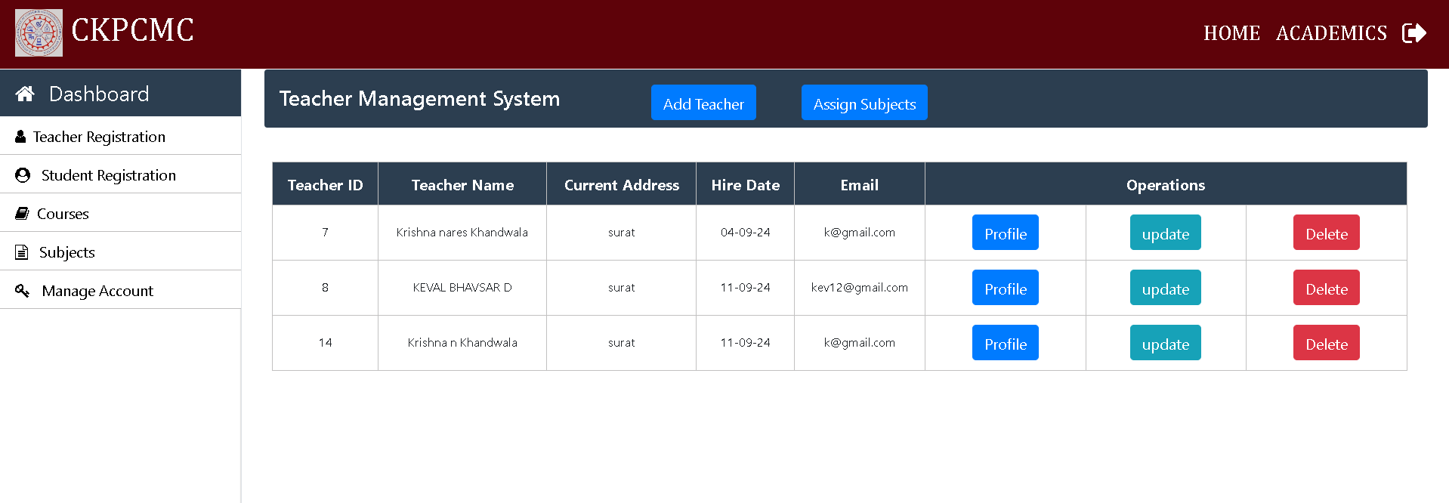
Admin-Dashboard
Use:- Here Admin Can Add Update And Delete Teacher And Also Assign Subject To the Teacher

Slide 38
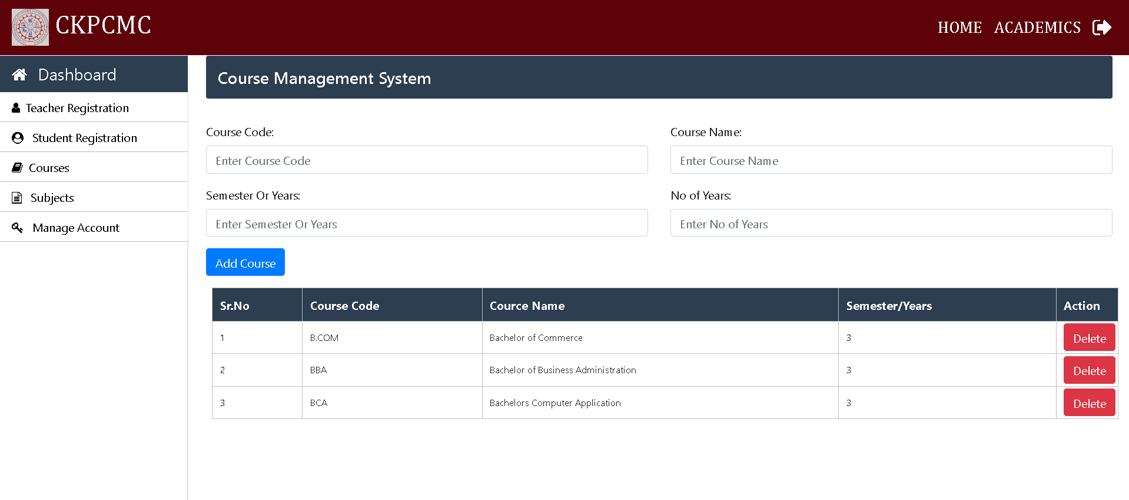
Admin-Dashboard
Use:- Here Admin Can Add Course like B.B.A, B.C.A,B.com

Slide 39
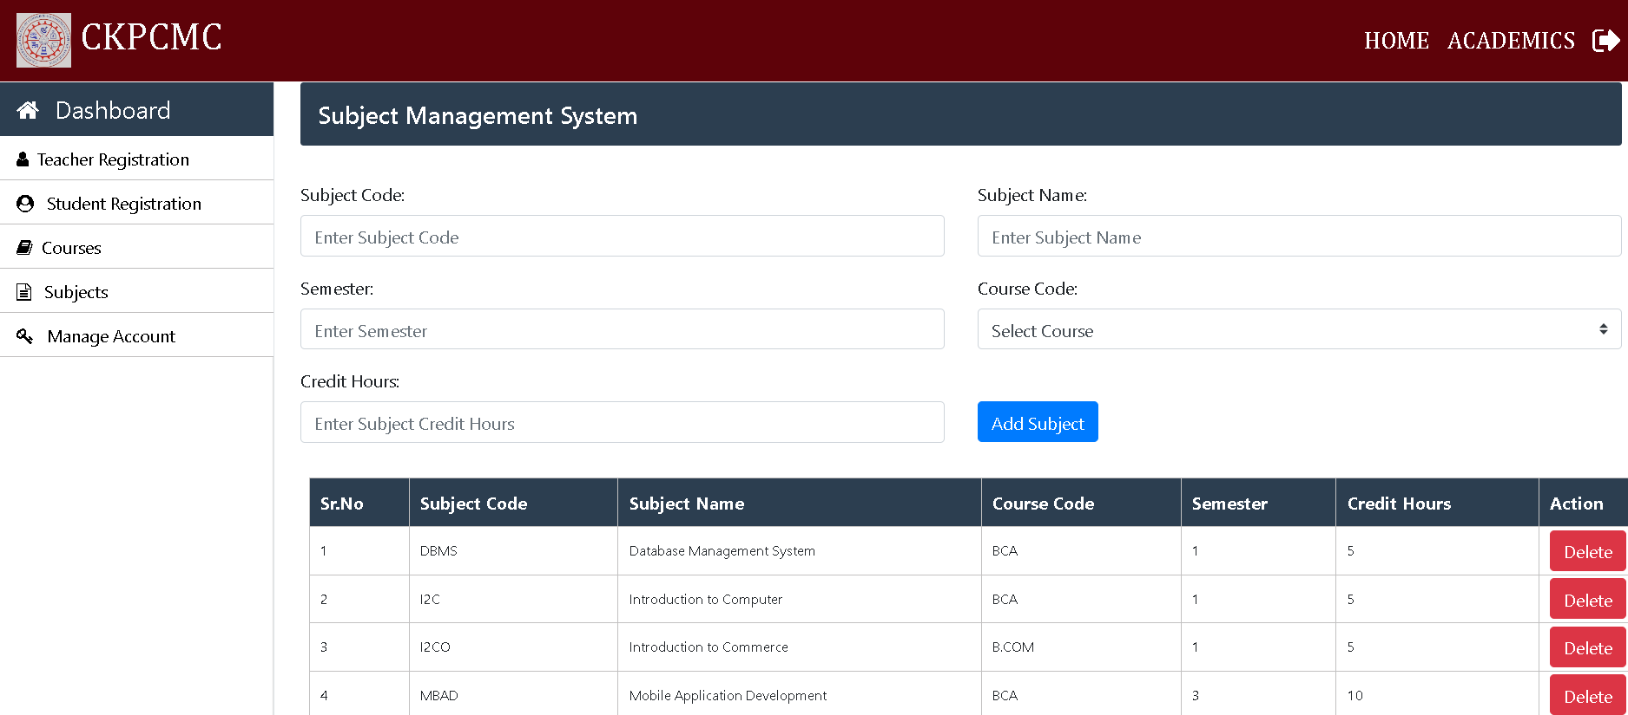
Admin-Dashboard
Use:- Here Admin Can Add Subject Course Like Cppm, Unix Web-Designing

Slide 40
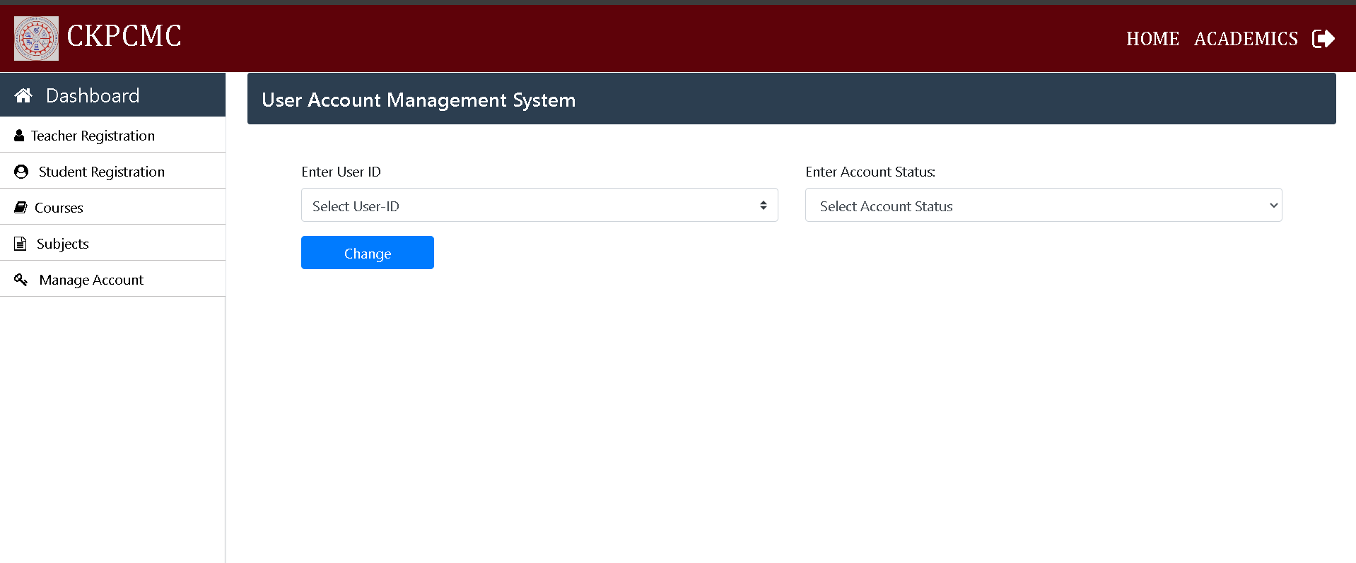
Admin-Dashboard
Use:- Here Admin Can Manage Student And teacher Accunt Like Active And Inactive If Admin inactive Account Student and Teacher Can not login in the account

Slide 41
Admin-Dashboard
Use:- Here Admin Can Manage Student And teacher Accunt Like Active And Inactive If Admin inactive Account Student and Teacher Can not login in the account

Slide 42
Teacher-Panel

Slide 43

Student-Login
Use:- Here Teacher Can Login It’s Account

Slide 44
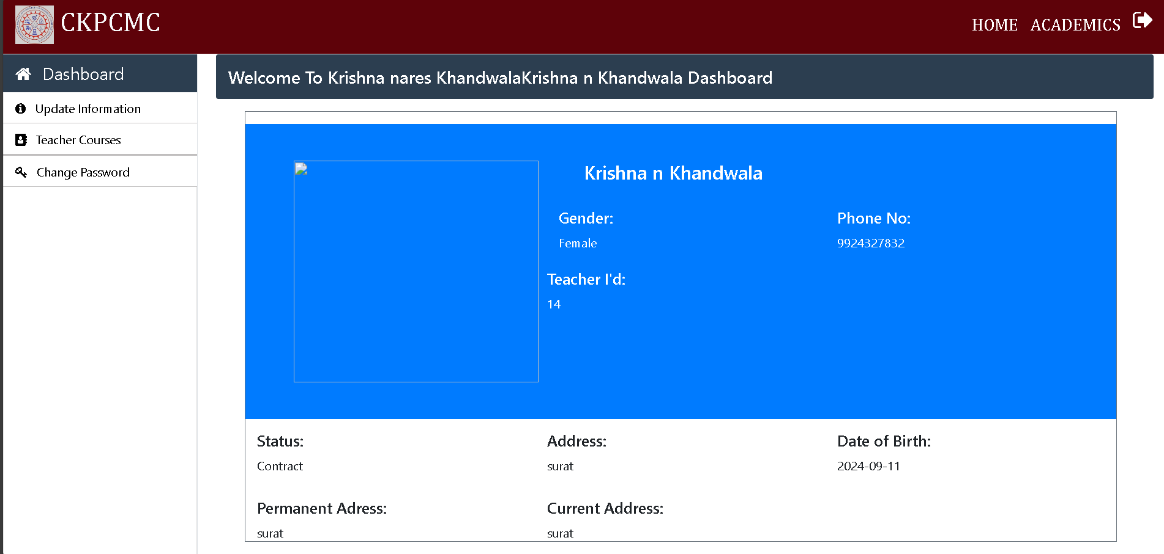
Teacher-Dashboard
Use:- Here Teacher Can Show Their Profile And Update Information
Also Teacher can See Assign subject given by Admin And Teacher also Can Change Account Password

Slide 45
Student-Panel

Slide 46
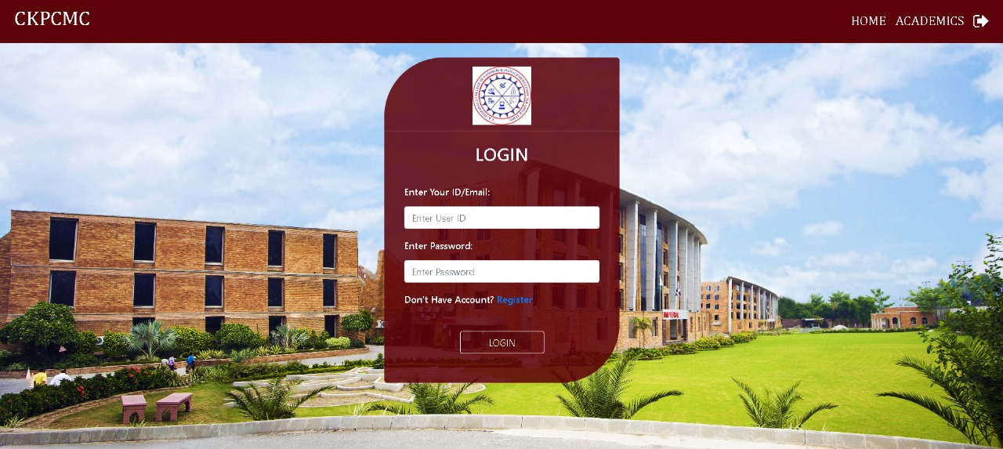
Teacher-Login
Use:- Here Student Can Login It’s Account

Slide 47
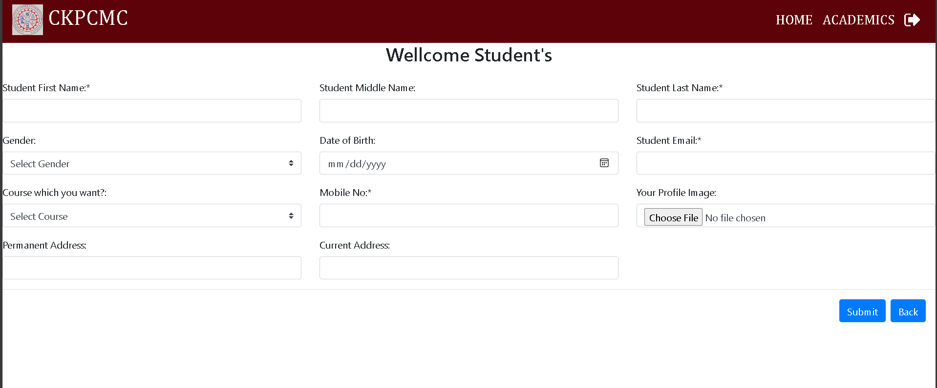
Student Registration Page
Use:- Here Student Can Register Their Account

Slide 48
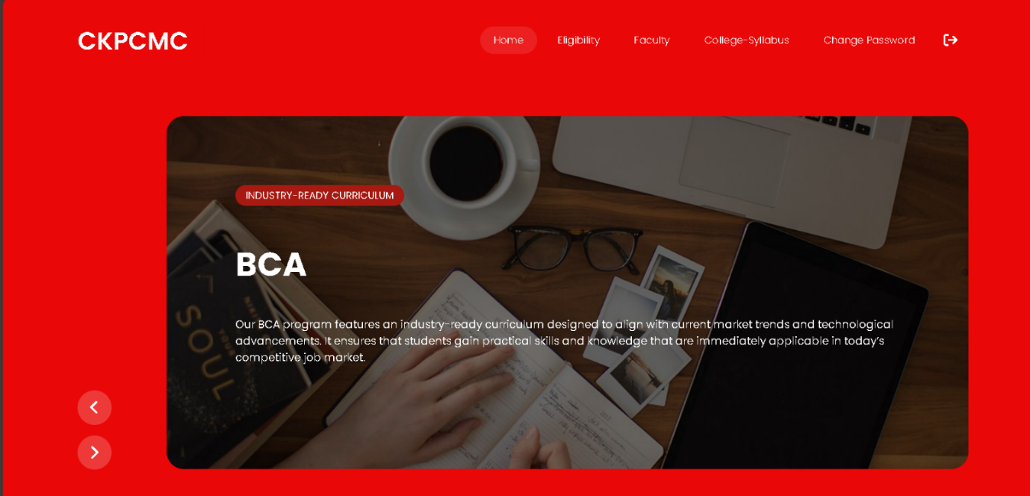
Student-Home Page
Use:- After Login Student can See home page Here Student can See All Detail Of College And Course

Slide 49
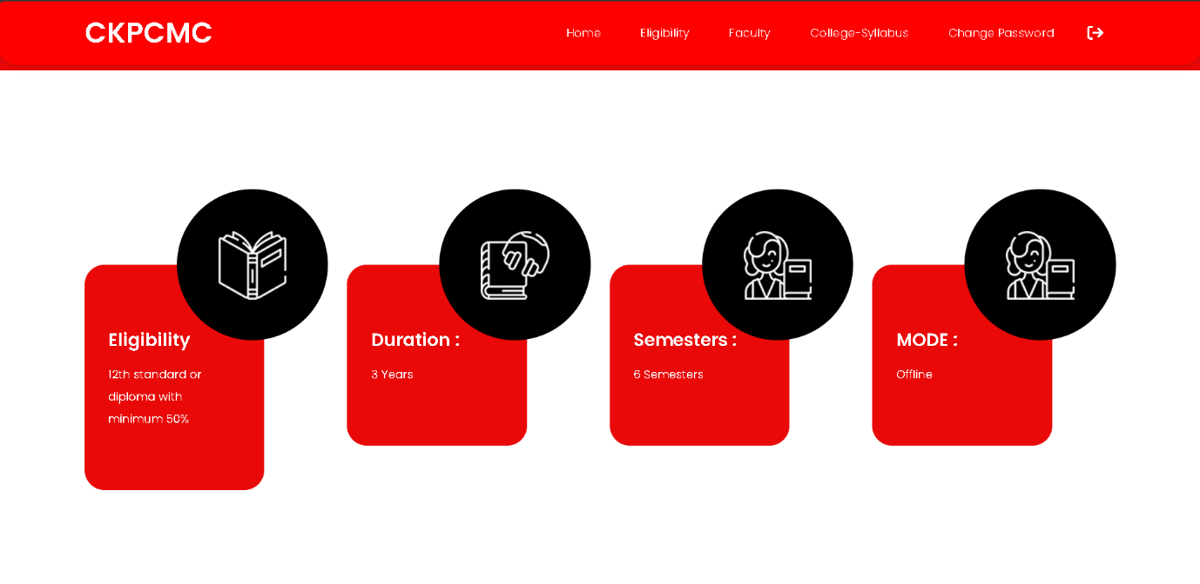
Student-Home Page
Use:- Here Student can See Eligibility Duration Course Semesters Course Semesters Course etc.

Slide 50
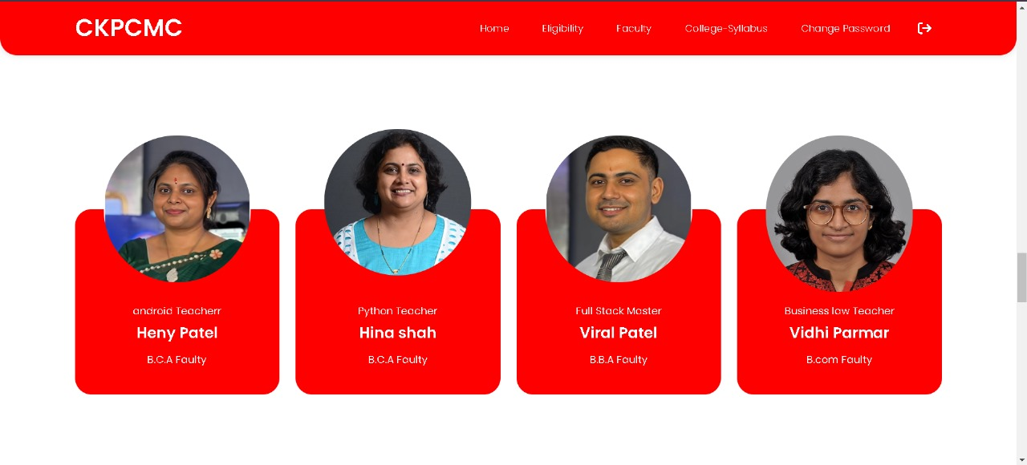
Student-Home Page
Use:- Here Student can See Different Department Faculty

Slide 51
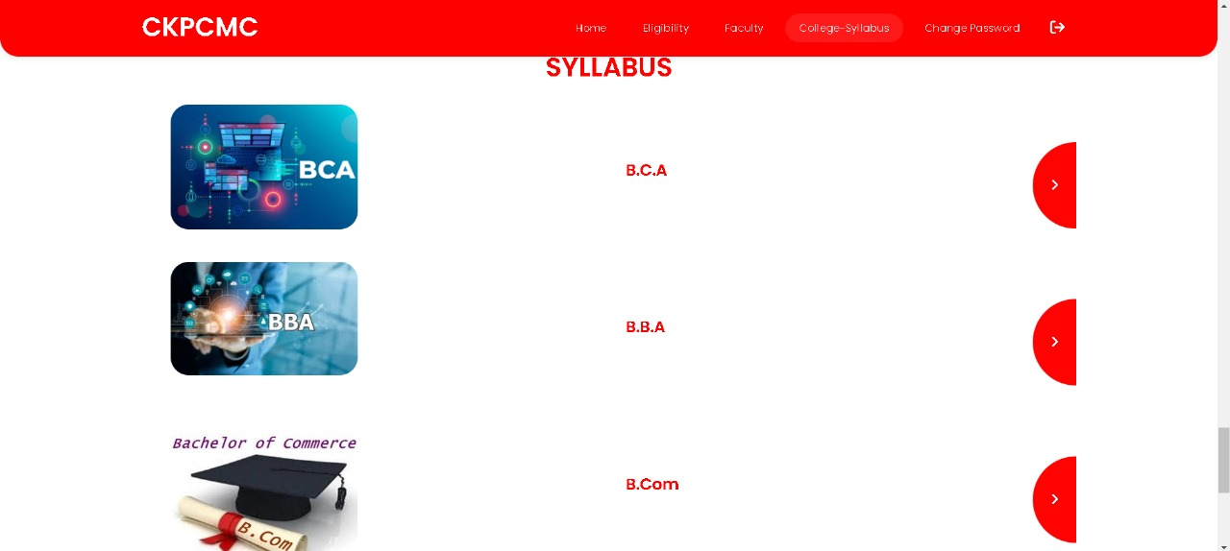
Student-Home Page
Use:- Here Student Show Course Like BBA BCA BCom for Download Subjects Notes

Slide 52
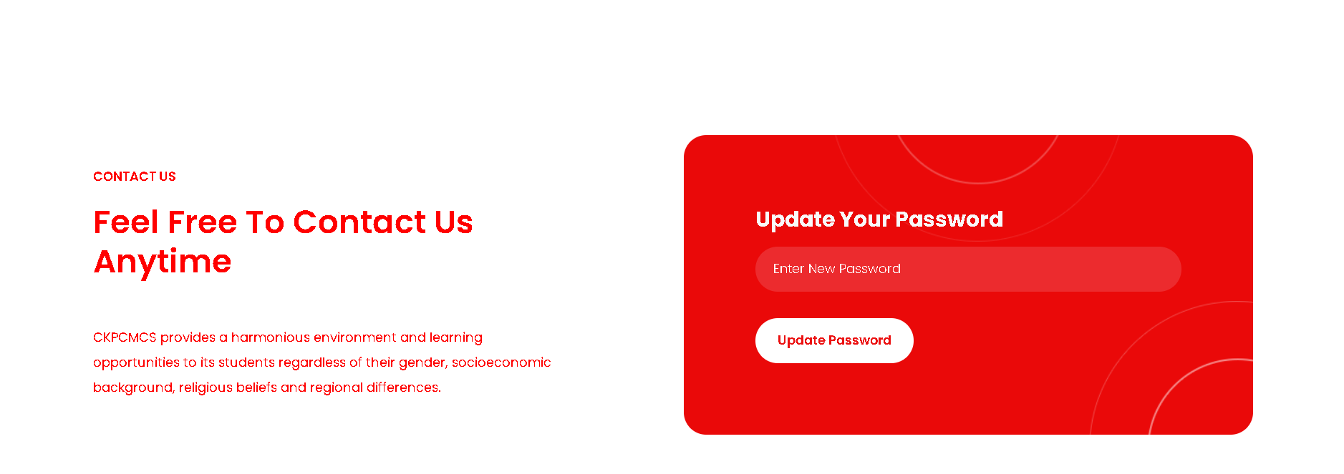
Student-Home Page
Use:- Here Student Show can change Their Account Password

Slide 53
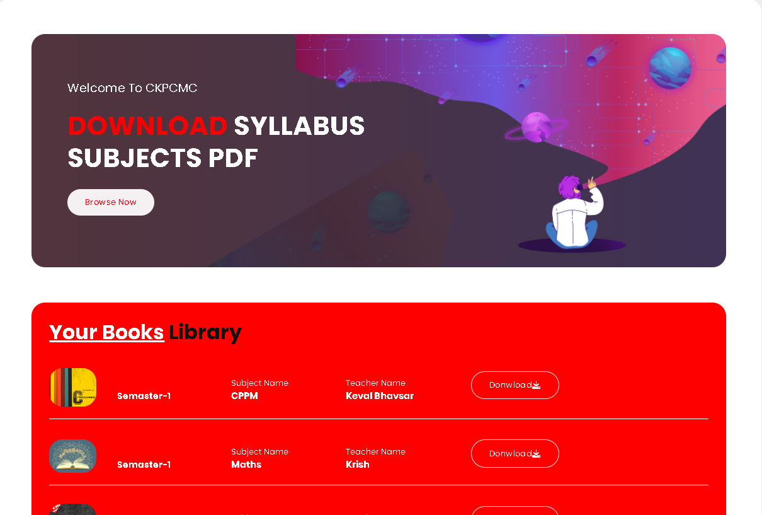
Student-Home Page
Use:- Here Student Only Download B.C.A Subject Notes

Slide 54
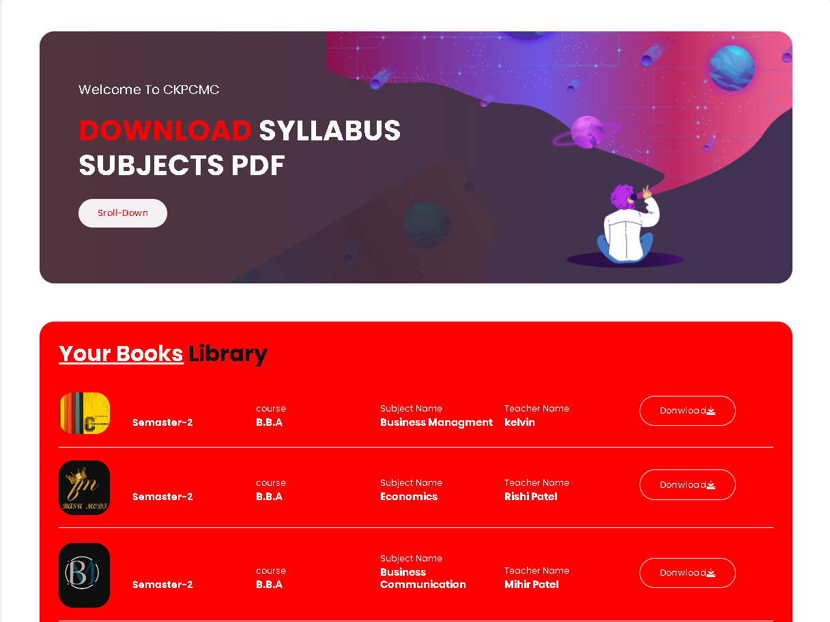
Student-Home Page
Use:- Here Student Only Download B.B.A Subject Notes

Slide 55
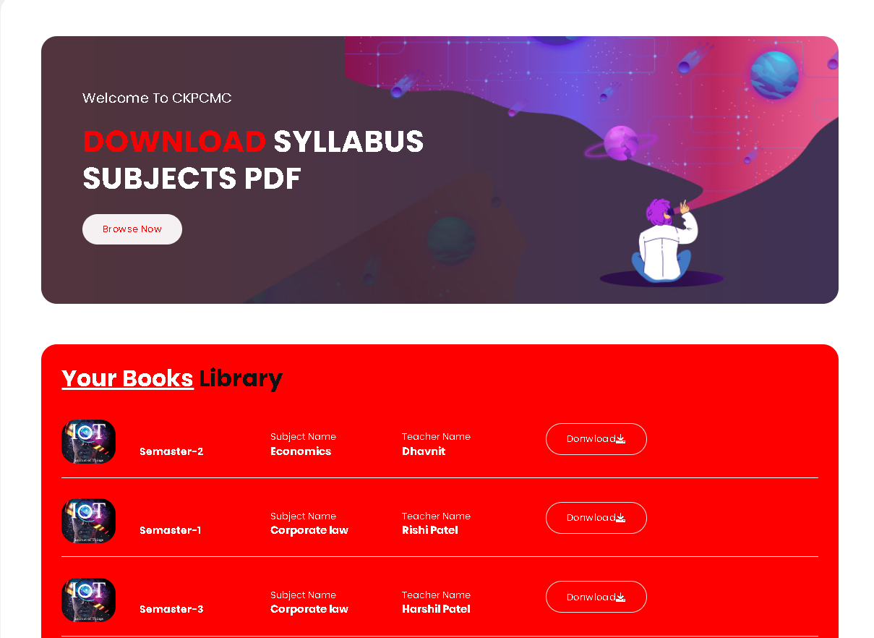
Student-Home Page
Use:- Here Student Only Download B.com Subject Notes

Slide 56
Thank You

